Slide 1
Capstone Project – Sakila DVD Rental Store
Sree Harshitha Thikkireddi
DATA ANALYTICS

Slide 2
01
OBJECTIVE
The purpose and aim of the analysis.
TABLE
OF CONTENTS
02
DATA DICTIONARY
Definitions and descriptions of key database tables and fields.
03
ROUGH LAYOUT OF DASHBOARD
A visual representation of the Power BI dashboard structure and content.

Slide 3
OBJECTIVE OF THE ANALYSIS
The primary objective of the analysis of the Sakila DVD Rental Store database (2005-2006) is to gain valuable insights into the rental business's operational and customer-related aspects. This analysis aims to uncover patterns, trends, and factors that can significantly impact the store's performance, customer satisfaction, and revenue generation. By exploring various dimensions of the database, we seek to provide actionable recommendations to optimize operations and enhance the overall customer experience.

Slide 4
Furthermore, our analysis strives to answer key questions such as the impact of inventory availability on customer satisfaction, rental frequency over time, and rental completion rates. By delving into these questions, we aim to contribute to better decision-making, strategic planning, and improved business intelligence for the Sakila DVD Rental Store. Ultimately, our objective is to assist the store in maximizing customer satisfaction, increasing rental frequency, and achieving sustainable growth in a competitive market.

Slide 5
DATA DICTIONARY
TABLES:
Actor
Address
Category
City
Customer
Film
Film_Actor
Film_Category
Film_Text
Inventory
Language
Payment
Rental
Staff
Store

Slide 6
Table: Actor
actor_id | Unique identifier for each actor.
first_name | First name of the actor.
last_name | Last name of the actor.
last_update | Date of the last update.
Table: Address
address_id | Unique identifier for each address.
address | Street address.
address2 | Additional address information (blank).
district | District or region.
city_id | Foreign key referencing the city_id in the city table.
postal_code | Postal code.
phone | Phone number.
location | Location of the address
last_update | Date of the last update.

Slide 7
Table: Country
country_id | Unique identifier for each country.
country | Country name.
last_update | Date of the last update.
Table: City
city_id | Unique identifier for each city.
city | City name.
country_id | Foreign key referencing the country_id in the Country table.
last_update | Date of the last update.
Table: Category
category_id | Unique identifier for each category.
name | Name of the category.
last_update | Date of the last update.

Slide 8
Table: Customer
customer_id | Unique identifier for each customer.
store_id | Foreign key referencing the store_id in the Store table.
first_name | First name of the customer.
last_name | Last name of the customer.
email | Email address of the customer.
address_id | Foreign key referencing the address_id in the Address table.
active | Boolean value indicating whether the customer is active.
create_date | Date when the customer record was created.
last_update | Date of the last update to the customer record.
Table: Inventory
inventory_id | Unique identifier for each inventory item.
film_id | Foreign key referencing the film_id in the Film table.
store_id | Foreign key referencing the store_id in the Store table.
last_update | Date of the last update.

Slide 9
Table: Film
film_id | Unique identifier for each film.
title | Title of the film.
description | Description of the film.
release_year | Year when the film was released.
language_id | Foreign key referencing the language_id in the Language table.
original_language_id | Foreign key referencing the language_id in the Language table for the original language of the film.
rental_duration | Rental duration of the film.
rental_rate | Rental rate of the film.
length | Length of the film in minutes.
replacement_cost | Replacement cost of the film.
rating | Rating of the film.
special_features | Special features of the film.
last_update | Date of the last update to the film record.

Slide 10
Table: Film_Category
film_id | Foreign key referencing the film_id in the Film table.
category_id | Foreign key referencing the category_id in the Category table.
last_update | Date of the last update.
Table: Film_Actor
actor_id | Foreign key referencing the actor_id in the Actor table.
film_id | Foreign key referencing the film_id in the Film table.
last_update | Date of the last update.
Table: Film_Text
film_id | Unique identifier for each film.
title | Title of the film.
description | Description of the film.

Slide 11
Table: Language
language_id | Unique identifier for each language.
name | Name of the language.
last_update | Date of the last update.
Table: Payment
payment_id | Unique identifier for each payment.
customer_id | Foreign key referencing the customer_id field in the Customer table.
staff_id | Foreign key referencing the staff_id field in the Staff table.
rental_id | Foreign key referencing the rental_id field in the Rental table.
amount | Payment amount.
payment_date | Date when the payment was made.
last_update | Date of the last update.

Slide 12
Table: Rental
rental_id | Unique identifier for each rental.
rental_date | Date when the rental was made.
inventory_id | Foreign key referencing the inventory_id field in the Inventory table.
customer_id | Foreign key referencing the customer_id field in the Customer table.
return_date | Date when the rental was returned.
staff_id | Foreign key referencing the staff_id field in the Staff table.
last_update | Date of the last update to the rental record.
Table: Store
store_id | Unique identifier for each store.
 | Foreign key referencing the staff_id field in the Staff table for the store manager.
address_id | Foreign key referencing the address_id field in the Address table for the store location.
last_update | Date of the last update to the store record.

Slide 13
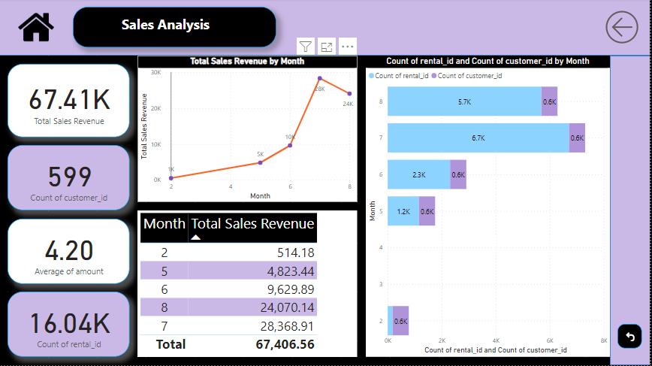

Slide 14
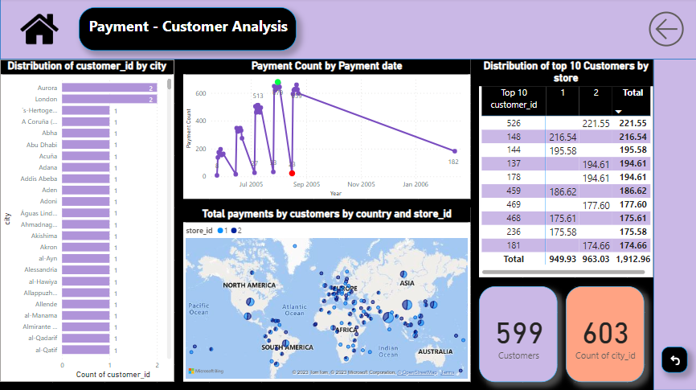

Slide 15
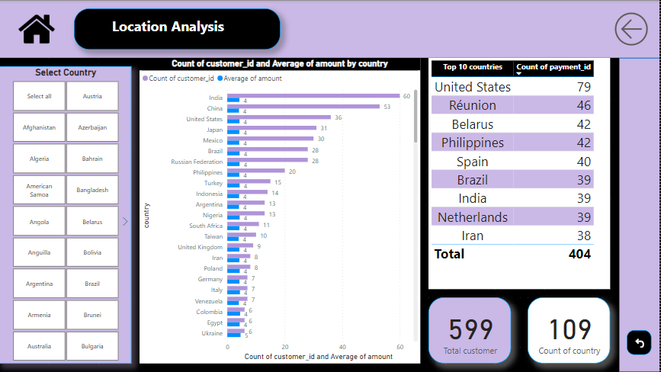

Slide 16
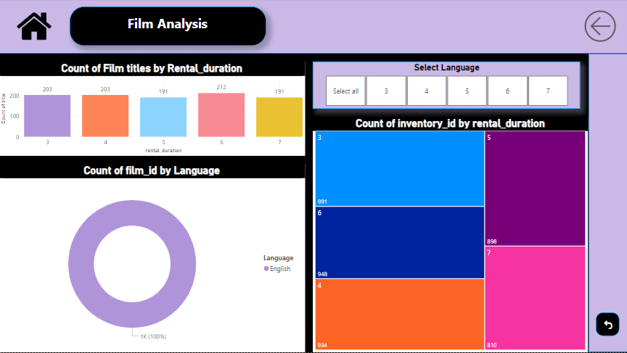

Slide 17
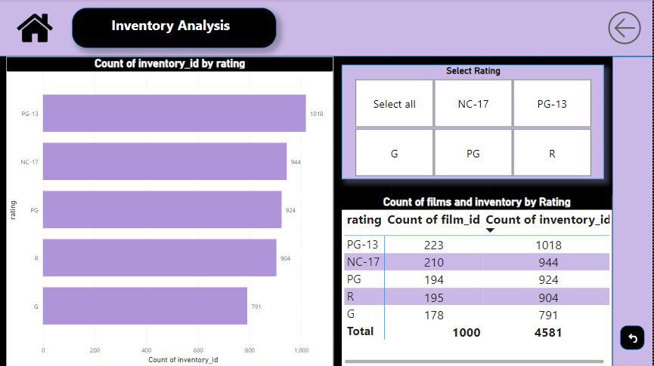

Slide 18
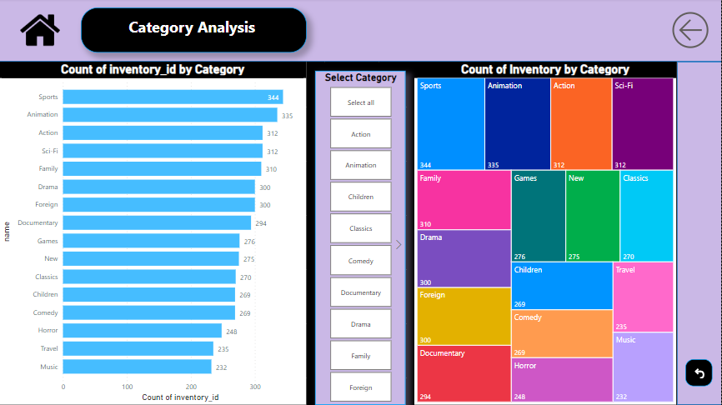

Slide 19
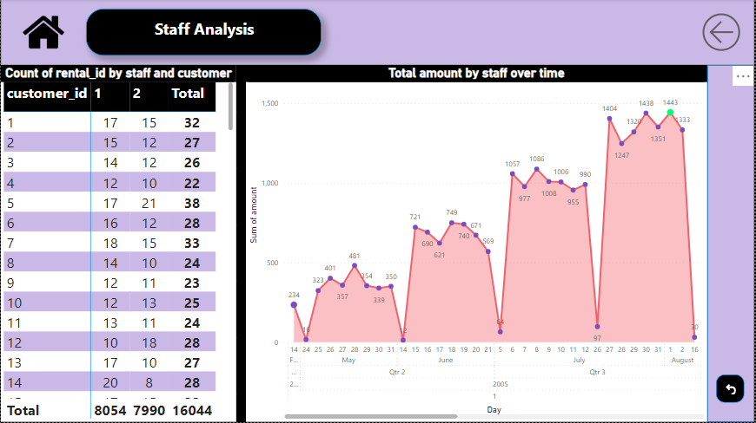

Slide 20
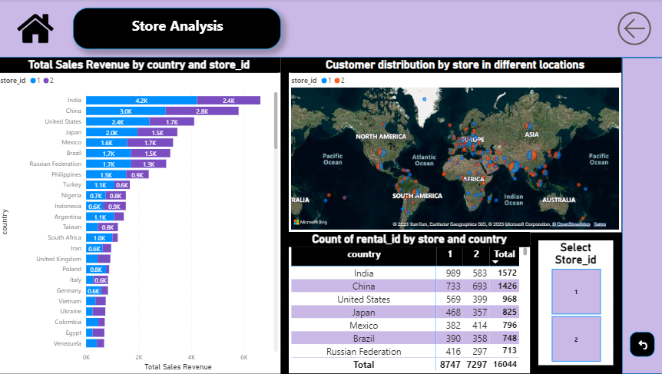

Slide 21
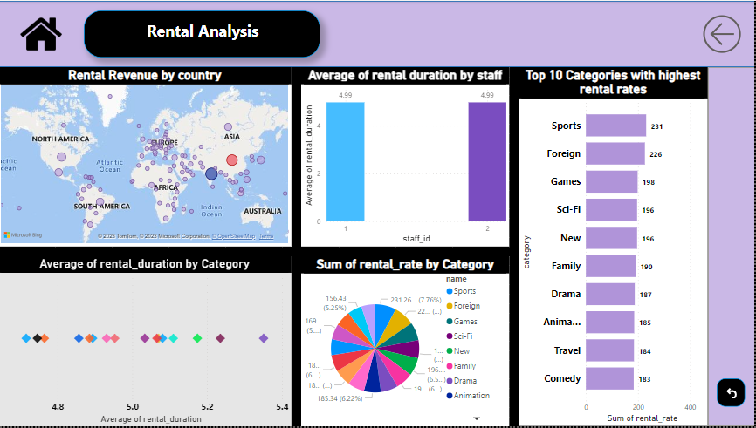

Slide 22
Thank You!
Detailed Findings and Explanations
Will Be Provided in the Final Presentation.

